Slide 1
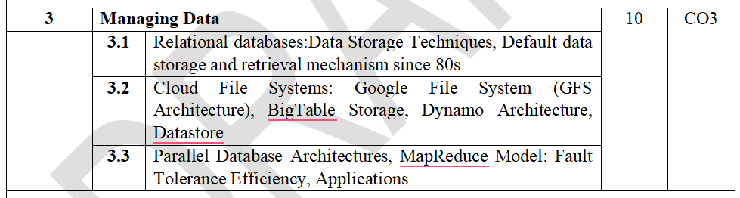
Module 3: Managing Data

Slide 2
Introduction to Data Management
Introduction to Data Management
What is Data?
Data is a collection of raw facts that can be processed to produce meaningful information.
Examples
Student marks
Customer details
Bank transactions
Sensor readings
Product information
StudentId Name Marks
101 Rahul 85
102 Priya 97

Slide 3
Introduction to Data Management
_{What is a Database?}
A database is an organized collection of related data stored electronically for easy access, retrieval, modification, and management.
_{Characteristics:}
_{Organized structure}
_{Reduced redundancy}
_{Data integrity}
_{Easy retrieval}
_{Security}
_{Multi-user access}

Slide 4
Introduction to Data Management
_{What is a Database?}
_{Examples}
_{Banking Database}
_{Hospital Database}
_{Railway Reservation Database}
_{University Database}
_{E-commerce Database}

Slide 5
Introduction to Data Management
_{Why Do We Need Databases?}
_{Without databases:}
_{Data is duplicated.}
_{Searching becomes difficult.}
Updating information is time-consuming.
_{Data inconsistency occurs.}
_{With databases:}
_{Faster search}
_{Better security}
_{Efficient storage}
_{Concurrent access}
_{Reliable backup and recovery}

Slide 6
Introduction to Data Management
DBMS = Database Management System
A DBMS is software that allows users/applications to:
_{Create databases}
_{Store data}
_{Retrieve data}
_{Update data}
_{Delete data}
_{Manage users and permissions}
Maintain data security and integrity
A DBMS does not necessarily require data to be stored in related tables.
Examples of database systems that are generally classified as non-relational DBMSs include some document, key-value, graph, and other database systems.

Slide 7
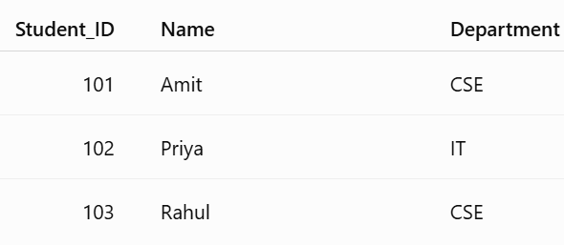
Introduction to Data Management
RDBMS = Relational Database Management System
It is a DBMS based on the relational model, where data is primarily organized into tables (relations).
For example:
STUDENT

Slide 8

Introduction to Data Management
RDBMS = Relational Database Management System
COURSE
The tables can be related using keys.

Slide 9
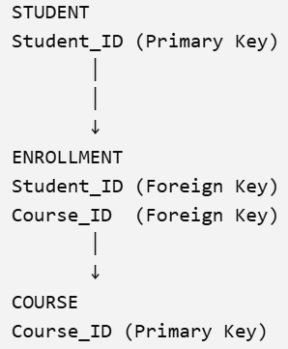
Introduction to Data Management
RDBMS = Relational Database Management System
For example:

Slide 10
Introduction to Data Management
Introduction to Relational Databases
What is a Relational Database?
A Relational Database Management System (RDBMS) stores data in the form of tables (relations).
Each table consists of:
Rows (Records/Tuples)
Columns (Attributes)

Slide 11

Introduction to Data Management
Introduction to Relational Databases
Student Table:

Slide 12
Introduction to Data Management
Components of a Relational Database
Table (Relation)
Stores information about one entity.
Example
Employee Table
Row (Tuple)
Represents one complete record.
Example
101 | Rahul | Computer | 20

Slide 13
Introduction to Data Management
Components of a Relational Database
Column (Attribute):
Represents one property.
Example
Student Name
Department
Age
Primary Key:
Uniquely identifies each row.
Example
StudentID

Slide 14
Introduction to Data Management
Components of a Relational Database
Foreign Key
Creates relationships between tables.
Example:
Student Table
StudentID
DepartmentID
Department Table
DepartmentID
DepartmentName

Slide 15
Introduction to Data Management
Why are Relational Databases Popular?
Structured format
Easy querying using SQL
Data consistency
ACID transactions
Strong security
Standardized model

Slide 16
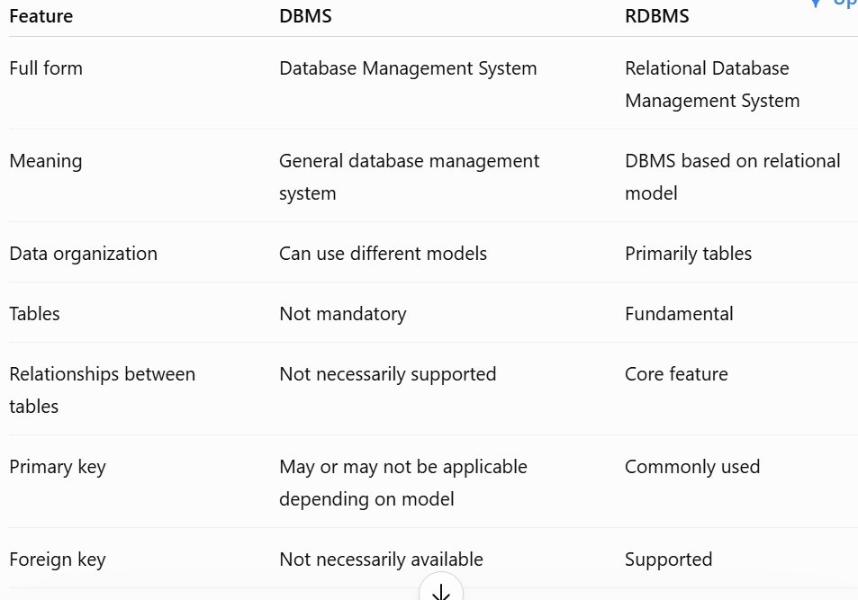
Introduction to Data Management
RDBMS = Relational Database Management System
For example:

Slide 17
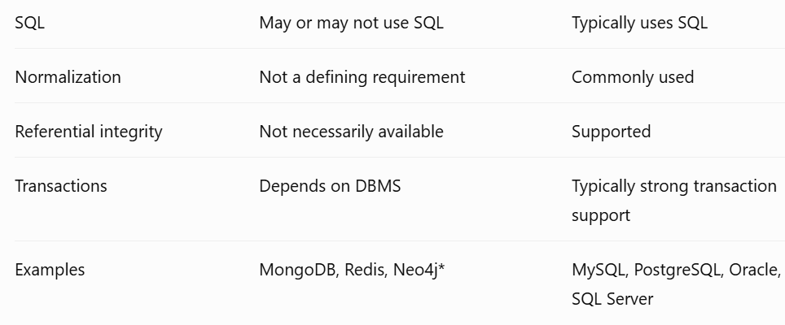
Introduction to Data Management

Slide 18
Introduction to Data Management
Scenario: A university is developing a Student Information System. Which storage technique would you recommend for the following tasks?
Recording student fee payments.
Generating department-wise performance reports.
Searching a student by roll number.
Importing admission records in bulk.

Slide 19
Introduction to Data Management
Scenario: A university is developing a Student Information System. Which storage technique would you recommend for the following tasks?
Expected Answers:
Fee payments → Row-Oriented Storage
Performance reports → Column-Oriented Storage
Search by roll number → Indexed Storage
Bulk admission import → Heap File Storage

Slide 20
Relational databases: Data storage techniques
A relational database is a type of database that stores data in the form of tables (relations) consisting of rows (records) and columns (attributes).
Data is organized efficiently to reduce redundancy and maintain consistency using relationships between tables.

Slide 21
Relational databases: Data storage techniques
Data Storage Techniques in Relational Databases
1. Table-Based Storage
The primary storage technique in relational databases is the table.
Each table represents one entity (e.g., Student, Employee, Customer).
Each row represents one record.
Each column represents an attribute of the entity.
Every table has a unique name.

Slide 22

Relational databases: Data storage techniques
Data Storage Techniques in Relational Databases
1. Table-Based Storage
Example: Student Table
Advantages:
Simple organization
Easy retrieval and maintenance
Supports SQL operations efficiently

Slide 23

Relational databases: Data storage techniques
Data Storage Techniques in Relational Databases
2. Row-Oriented Storage
In row-oriented storage, all values of a single record are stored together.
Storage Example
Characteristics:
Entire record is stored contiguously.
Fast for transaction processing (OLTP).
Suitable for INSERT, UPDATE, and DELETE operations.

Slide 24
Relational databases: Data storage techniques
Data Storage Techniques in Relational Databases
2. Row-Oriented Storage
Advantages:
Efficient retrieval of complete records.
Faster updates.
Ideal for banking, e-commerce, ERP systems.
Disadvantages:
Slower analytical queries that access only a few columns.
Reads unnecessary data during large reports.

Slide 25
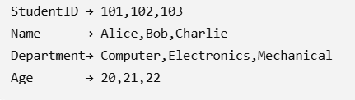
Relational databases: Data storage techniques
Data Storage Techniques in Relational Databases
3. Column-Oriented Storage
In column-oriented storage, values from the same column are stored together.
Storage Example
Characteristics:
Data stored column by column.
Excellent compression.
Optimized for analytical processing (OLAP).

Slide 26
Relational databases: Data storage techniques
Data Storage Techniques in Relational Databases
3. Column-Oriented Storage
Advantages:
Fast aggregate functions (SUM, AVG, COUNT).
Better compression.
Efficient for data warehouses.
Disadvantages:
Slower insertion and updates.
Not suitable for frequent transactions.

Slide 27
Relational databases: Data storage techniques
Data Storage Techniques in Relational Databases
4. Heap File Organization
Records are stored without any specific order.
105
102
110
101
108
103
Records are generally inserted wherever free space is available.
Characteristics:
New records are added at the end.
Simple implementation.

Slide 28
Relational databases: Data storage techniques
Data Storage Techniques in Relational Databases
4. Heap File Organization
Advantages:
Very simple
Fast insertion
Suitable when records are frequently inserted
No need to maintain ordering
Disadvantages:
Slow searching
Full table scan often required

Slide 29

Relational databases: Data storage techniques
Data Storage Techniques in Relational Databases
5. Sequential File Organization
Records are stored sorted according to the primary key.
Characteristics
Records maintained in sorted order.

Slide 30
Relational databases: Data storage techniques
Data Storage Techniques in Relational Databases
5. Sequential File Organization
Advantages:
Fast sequential access
Efficient range queries
Disadvantages
Slow insertion and deletion
Reorganization may be needed

Slide 31

Relational databases: Data storage techniques
Data Storage Techniques in Relational Databases
6. Indexed Storage
An index is a separate data structure that stores the location of records.
Think of an index like the index of a textbook.
Example Index

Slide 32
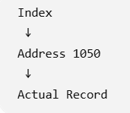
Relational databases: Data storage techniques
Data Storage Techniques in Relational Databases
6. Indexed Storage
When searching StudentID = 102:
Types of Indexes:
Primary Index
Secondary Index
Clustered Index
Non-Clustered Index

Slide 33
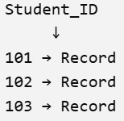
Relational databases: Data storage techniques
Data Storage Techniques in Relational Databases
6. Indexed Storage
Types of Indexes:
Primary Index
Created based on the primary key.
Example:
Primary keys are generally indexed automatically by many DBMSs, though the exact behavior depends on the DBMS.

Slide 34
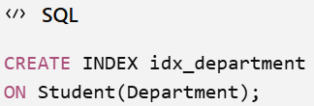
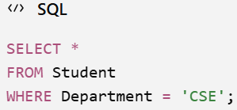
Relational databases: Data storage techniques
Data Storage Techniques in Relational Databases
6. Indexed Storage
Types of Indexes:
Secondary Index
An index created on a non-primary-key attribute.
Example:
Now queries such as:
can potentially use this index.

Slide 35

Relational databases: Data storage techniques
Data Storage Techniques in Relational Databases
6. Indexed Storage
Types of Indexes:
Clustered Index
A clustered index determines or closely corresponds to the physical ordering of table data.
Conceptually: Our table contains

Slide 36
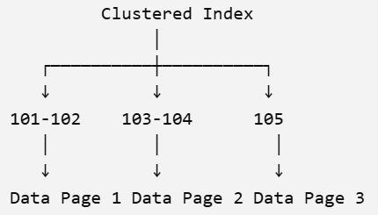
Relational databases: Data storage techniques
Data Storage Techniques in Relational Databases
6. Indexed Storage
Types of Indexes:
Clustered Index
Imagine the clustered index is built on Student_ID.
Conceptually:
The important point is that the leaf level contains the table's actual data (in systems such as SQL Server when the table has a clustered index).

Slide 37
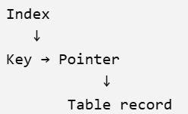
Relational databases: Data storage techniques
Data Storage Techniques in Relational Databases
6. Indexed Storage
Types of Indexes:
Non-clustered Index
The index is maintained separately from the table data.
A table can generally have multiple non-clustered indexes.

Slide 38
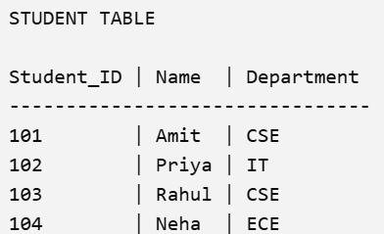
Relational databases: Data storage techniques
Data Storage Techniques in Relational Databases
6. Indexed Storage
Types of Indexes:
Non-clustered Index
Suppose our actual table is:
We create a non-clustered index on:
Name

Slide 39
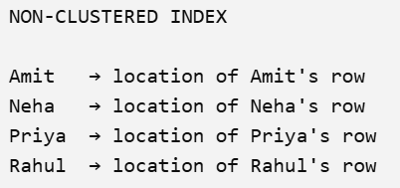
Relational databases: Data storage techniques
Data Storage Techniques in Relational Databases
6. Indexed Storage
Types of Indexes:
Non-clustered Index
The index might conceptually look like:
The actual table remains separate.

Slide 40
Relational databases: Data storage techniques
Data Storage Techniques in Relational Databases
6. Indexed Storage
Advantages:
Very fast searching
Efficient sorting
Faster joins
Disadvantages:
Extra storage required
Slightly slower insert/update operations

Slide 41
Relational databases: Data storage techniques
Data Storage Techniques in Relational Databases
7. Hash-Based Storage
A hash function converts a key into a storage location.
Hash(Key) → Bucket
Example:
StudentID 101 → Bucket 5
StudentID 102 → Bucket 2
StudentID 103 → Bucket 7
Advantages:
Very fast equality search
Average O(1) lookup
Disadvantages:
Poor for range queries
Collisions must be handled

Slide 42
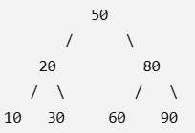
Relational databases: Data storage techniques
Data Storage Techniques in Relational Databases
8. B-Tree and B+ Tree Storage
Most relational databases use B+ Trees for indexing.
Advantages:
Balanced tree
Fast search
Fast insertion
Fast deletion
Supports range queries
Time Complexity:
Search: O(log n)
Insert: O(log n)
Delete: O(log n)

Slide 43
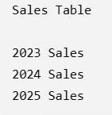
Relational databases: Data storage techniques
Data Storage Techniques in Relational Databases
9. Partitioning
Large tables are divided into smaller partitions.
Example
Types:
Horizontal Partitioning
Vertical Partitioning
Range Partitioning
Hash Partitioning
List Partitioning
Advantages:
Faster queries
Easier maintenance
Improved scalability

Slide 44
Relational databases: Data storage techniques
Data Storage Techniques in Relational Databases
10. Compression
Data is compressed to reduce storage.
Types
Row Compression
Column Compression
Dictionary Compression
Run-Length Encoding (RLE)
Advantages
Saves disk space
Faster backups
Improved cache performance

Slide 45

Relational databases: Data storage techniques
Data Storage Techniques in Relational Databases
11. Normalization
Normalization organizes data into multiple related tables to eliminate redundancy.
Example (Before)

Slide 46

Relational databases: Data storage techniques
Data Storage Techniques in Relational Databases
11. Normalization
Example (After Normalization)

Slide 47
Relational databases: Data storage techniques
Data Storage Techniques in Relational Databases
11. Normalization
Advantages
Reduces redundancy
Improves consistency
Easier maintenance

Slide 48
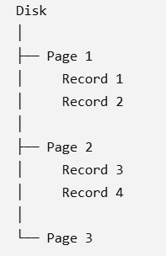
Relational databases: Data storage techniques
Data Storage Techniques in Relational Databases
12. Data Pages and Blocks
Databases store data in fixed-size pages (blocks) rather than individual records.
Advantages:
Efficient disk I/O
Better caching
Faster access

Slide 49
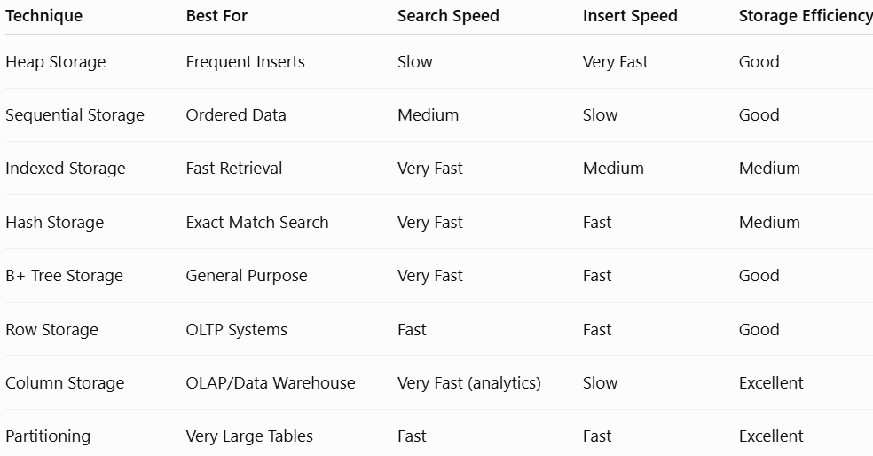
Relational databases: Data storage techniques
Comparison of Data Storage Techniques

Slide 50
Relational databases: Data storage techniques
Applications
Banking Systems: Row storage, B+ tree indexes
E-commerce: Indexed and partitioned storage
Data Warehouses: Column storage with compression
Hospital Management Systems: Row-oriented storage with indexes
Library Management Systems: B+ tree indexing and normalization
Online Reservation Systems: Indexed and hash-based storage

Slide 51
Relational Databases – Default Data Storage and Retrieval Mechanism Since the 1980s
1. Evolution of Database Systems
Early File-Based Systems (Before 1980)
Before relational databases, organizations stored data in files.
Examples:
Text files
CSV files
Binary files
Example
Student.txt
101 Rahul Computer
102 Priya IT
103 Amit Mechanical

Slide 52
Relational Databases – Default Data Storage and Retrieval Mechanism Since the 1980s
Early File-Based Systems (Before 1980)
Problems of File Systems:
Data redundancy
Data inconsistency
Difficult searching
No relationships between files
Poor security
Difficult backup

Slide 53
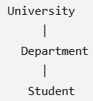
Relational Databases – Default Data Storage and Retrieval Mechanism Since the 1980s
Early File-Based Systems (Before 1980):
Hierarchical Database Model
Data was stored like a tree.
Advantages:
Fast parent-child access
Disadvantages:
Rigid structure
Difficult many-to-many relationships

Slide 54
Relational Databases – Default Data Storage and Retrieval Mechanism Since the 1980s
Introduction of the Relational Model (1970):
In 1970, Dr. Edgar F. Codd introduced the Relational Model, proposing that data should be organized into tables and manipulated using mathematical principles of relational algebra. This model later became the foundation of modern Relational Database Management Systems (RDBMS).

Slide 55
Relational Databases – Default Data Storage and Retrieval Mechanism Since the 1980s
Introduction of the Relational Model (1970):
Why Relational Databases Became the Default Storage Mechanism
From the 1980s onward, relational databases became the standard for enterprise data management because they offered a simple, reliable, and consistent way to store and retrieve structured data.
Reasons for their popularity
1. Table-Based Structure
Data is organized into tables.
Example
Student
StudentId Name Department
101 Rahul Comp Engg
102 Priya IT
Easy to understand and manage.

Slide 56
Relational Databases – Default Data Storage and Retrieval Mechanism Since the 1980s
Introduction of the Relational Model (1970):
2. Reduced Data Redundancy
Normalization eliminates duplicate data.
Without normalization
Student Department
Rahul Computer
Rahul Computer
With normalization
Student Table
ID Name
101 Rahul
Department Table
DeptID Department
D1 Computer

Slide 57
Relational Databases – Default Data Storage and Retrieval Mechanism Since the 1980s
Examples include:
Oracle Database
IBM DB2
Microsoft SQL Server
MySQL
PostgreSQL
Why Relational Databases Became Popular
Data organized in tables
Standard SQL language
Reduced redundancy
Improved consistency
Easier maintenance
Strong security
Reliable transaction processing

Slide 58
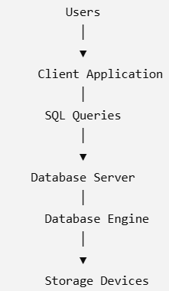
Relational Databases – Default Data Storage and Retrieval Mechanism Since the 1980s
2. Client-Server Database Architecture
Traditional relational databases use a Client-Server Architecture.

Slide 59
Relational Databases – Default Data Storage and Retrieval Mechanism Since the 1980s
2. Client-Server Database Architecture
Components
Client
The client is the application that requests data.
Examples:
Banking software
E-commerce website
College ERP
Hospital Management System
Functions:
Sends SQL queries
Receives query results
Displays information to users

Slide 60
Relational Databases – Default Data Storage and Retrieval Mechanism Since the 1980s
2. Client-Server Database Architecture
Database Server
The database server performs all database operations.
Responsibilities:
Store data
Process SQL queries
Execute transactions
Manage users
Provide security
Perform backups
Examples:
MySQL Server
Oracle Database Server
PostgreSQL Server

Slide 61
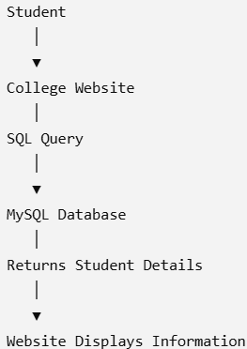
Relational Databases – Default Data Storage and Retrieval Mechanism Since the 1980s
2. Client-Server Database Architecture
Storage System
The actual database files are stored on:
Hard Disk Drives (HDD)
Solid State Drives (SSD)
RAID Storage
Example
Suppose a student logs into a college portal.

Slide 62

Relational Databases – Default Data Storage and Retrieval Mechanism Since the 1980s
3. SQL-Based Data Retrieval
SQL (Structured Query Language) is the standard language used to communicate with relational databases.
Example Table
Student

Slide 63
Relational Databases – Default Data Storage and Retrieval Mechanism Since the 1980s
3. SQL-Based Data Retrieval
SQL (Structured Query Language) is the standard language used to communicate with relational databases.
Example Table
Student
Retrieve All Records,Retrieve Specific Columns,Retrieve a Particular Student,Insert Data,Update Data,Delete Data
SQL provides a simple, standardized way to retrieve and manipulate data, which is one of the main reasons relational databases became widely adopted.

Slide 64
Relational Databases – Default Data Storage and Retrieval Mechanism Since the 1980s
4. ACID Properties
ACID properties ensure that database transactions are processed reliably.
A – Atomicity
A transaction is treated as a single unit of work.
Either:
Everything happens
Nothing happens
Example
A bank transfer of ₹5,000:
Account A → Account B
If money is deducted from Account A but not added to Account B because of a system failure, the transaction is rolled back.

Slide 65
Relational Databases – Default Data Storage and Retrieval Mechanism Since the 1980s
4. ACID Properties
ACID properties ensure that database transactions are processed reliably.
A – Atomicity
A transaction is treated as a single unit of work.
Either:
Everything happens
Nothing happens
Example
A bank transfer of ₹5,000:
Account A → Account B
If money is deducted from Account A but not added to Account B because of a system failure, the transaction is rolled back.
Result:No partial update occurs.

Slide 66
Relational Databases – Default Data Storage and Retrieval Mechanism Since the 1980s
4. ACID Properties
ACID properties ensure that database transactions are processed reliably.
C – Consistency
A transaction moves the database from one valid state to another.
Example
A student's CGPA cannot exceed the maximum allowed value.
Invalid data is rejected.

Slide 67
Relational Databases – Default Data Storage and Retrieval Mechanism Since the 1980s
4. ACID Properties
ACID properties ensure that database transactions are processed reliably.
I – Isolation
Multiple transactions should not interfere with each other.
Example:
Two users book the last available train seat simultaneously.
Isolation ensures that only one booking succeeds, preventing inconsistent data.

Slide 68
Relational Databases – Default Data Storage and Retrieval Mechanism Since the 1980s
4. ACID Properties
ACID properties ensure that database transactions are processed reliably.
D – Durability
Once a transaction is committed, it remains permanently stored even if the system crashes.
Example:
After an online payment is successful, the payment record is preserved despite a power failure.

Slide 69
Relational Databases – Default Data Storage and Retrieval Mechanism Since the 1980s
5. Transaction Management
A transaction is a sequence of operations performed as one logical unit.
Example:
BEGIN TRANSACTION
Debit Account A
Credit Account B
COMMIT
If an error occurs:
ROLLBACK

Slide 70


Relational Databases – Default Data Storage and Retrieval Mechanism Since the 1980s
5. Transaction Management
Transaction States
If an error occurs:

Slide 71
Relational Databases – Default Data Storage and Retrieval Mechanism Since the 1980s
6. Concurrency Control
In a multi-user environment, many users access the database at the same time.
Without concurrency control:
Lost updates
Dirty reads
Inconsistent data
Example
Account Balance = ₹10,000
User A withdraws ₹2,000.
User B withdraws ₹3,000 at the same time.
Without proper control, one transaction may overwrite the other, producing an incorrect balance.
Solution
Concurrency control techniques include:
Lock-based protocols
Timestamp ordering
Multiversion Concurrency Control (MVCC)

Slide 72
Relational Databases – Default Data Storage and Retrieval Mechanism Since the 1980s
7. Advantages of Traditional Relational Databases
Structured storage
SQL support
ACID transactions
Data integrity
Security
Mature technology
Reliable backups
Suitable for banking, ERP, healthcare, and university systems

Slide 73
Relational Databases – Default Data Storage and Retrieval Mechanism Since the 1980s
8. Limitations in Cloud Computing
Traditional relational databases work well for structured data but face challenges in cloud-scale environments:
Vertical scaling (adding more CPU/RAM) has limits.
Difficult to distribute across thousands of servers.
Schema changes can be complex.
Less suitable for rapidly changing or unstructured data.
High licensing costs for some enterprise databases.
These limitations motivated the development of distributed storage systems such as Google File System (GFS), BigTable, Amazon Dynamo, and other NoSQL databases.

Slide 74
Relational Databases – Default Data Storage and Retrieval Mechanism Since the 1980s
Case Study: Online Banking System
Identify how the system demonstrates each ACID property:
Atomicity: Both debit and credit occur, or neither does.
Consistency: Account balances remain valid after the transaction.
Isolation: Simultaneous transfers do not interfere with one another.
Durability: Once the transfer is confirmed, it is permanently recorded.

